Slide 1

Talent Management

Slide 2

Talent Management – Why?
QUESTIONS TO ANSWER
Do we attract and recruit
the right people?
Do we have the right people
at the right positions?
Do we develop
the right people?
Do we successfully retain
the right people?
MAIN GOAL: To define, attract, develop and retain the talent needed for the business development of the company and
to place the right person at the right place at the right time!

Slide 3
Talent Management
Definition
Talent management is an organization's commitment to recruit, retain and develop the most talented and superior employees available in the job market.

Slide 4

Talent Management
HR Challenges
Talent War
Employer of Choice
Airport as a working place
New generation specificities

Slide 5
Talent Management Process
PLAN
Understanding the requirement
SOURCE
Attracting & Recruitment
Appraisal
Training & Development
Career development
RETAIN
Recognition & Rewarding
DEVELOP

Slide 6
Talent Management in theory
Develop clear competency profiles with clearly defined skills, abilities, and experience needed from a new employee.
Select appropriate employees who have superior potential and fit the organization's culture, with an appropriate selection process.
Set performance standards, outcomes and measures
Provide effective employee onboarding and ongoing training and development opportunities that reflect both the employee's and the organization's needs.
Provide on-going coaching, mentoring, and feedback so the employee feels valued and important.
Design effective compensation and recognition systems that reward people for their contributions.
Provide career development opportunities for employees within a system that includes career paths, succession planning, and on-the-job training opportunities.
Hold exit interviews to understand why a valued employee decided to leave the organization. If the reasons provide information about company systems that you can improve, make the changes that will better retain talented employees.

Slide 7
Talent Management in practice
What competencies do we need to attract, keep and develop in the company?
Competency Model
How to assess the existing competencies?
Performance Appraisal
How to discover and promote internal talents?
Career Development Center
Talent Management
How to attract
external talents?
Internship Program
How to retain
the talent?
Recognition & Rewarding activities

Slide 8
Talent Management
Competency Model
Competencies needed for the business development of the company
Competency Profiles of each working place
Competencies to be trained and developed
Competencies to be attracted
Mission-Vision-Goals - KPI
Values & Culture

Slide 9
Talent Management
Competency Model
Selection & Recruitment
Remuneration & Benefits
Training
Performance Appraisal
Career Development
Exit

Slide 10
Talent Management
Performance Appraisal
1/ FIND OUT if the right persons are at the right places
2/ DISCOVER the talents in the company
3/ POINT OUT insufficient competencies at company level
4/ DETERMINE competencies to be trained
&
5/ HELP the employees find out their gaps of competencies
6/ DELIVER feedback to employees & obtain their views
7/ IMPROVE the communication between manager and subordinate
8/ PROVIDE means to determine fair bonus& increments

Slide 11
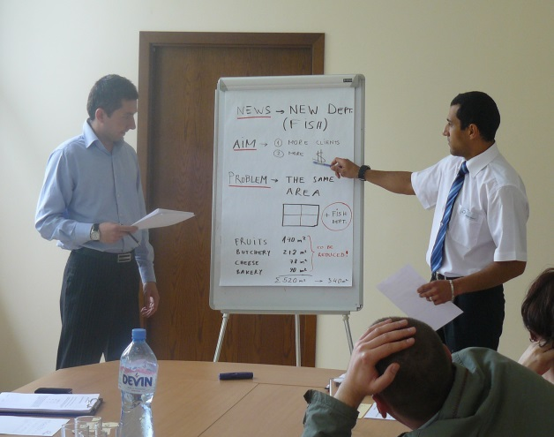
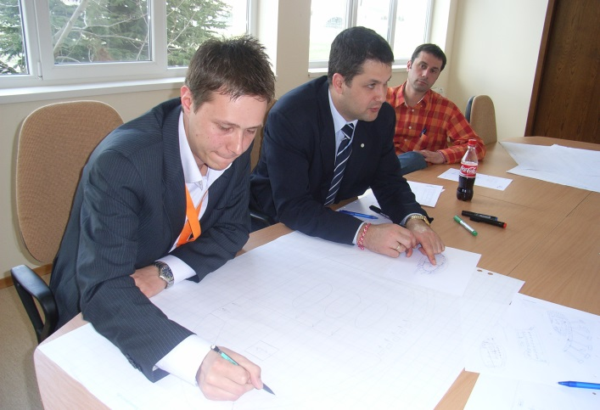
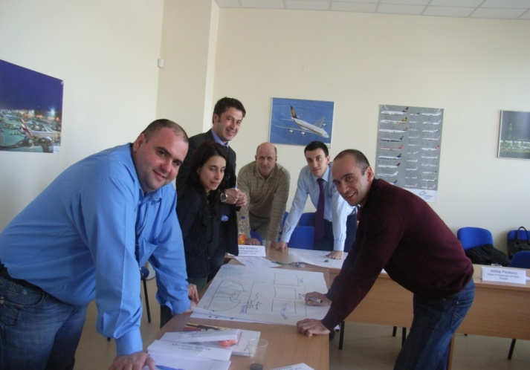
Talent Management
Career Development Programs
Young employees with high potential
Employees for management roles
Experienced employees with specific know-how
Professional & Personal skills
Leadership & Management skills
Mentoring & Coaching skills

Slide 12
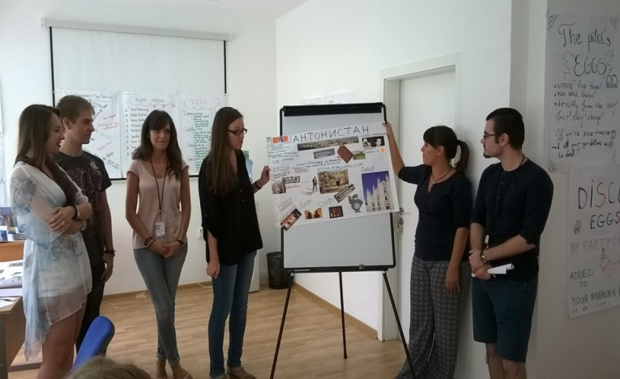
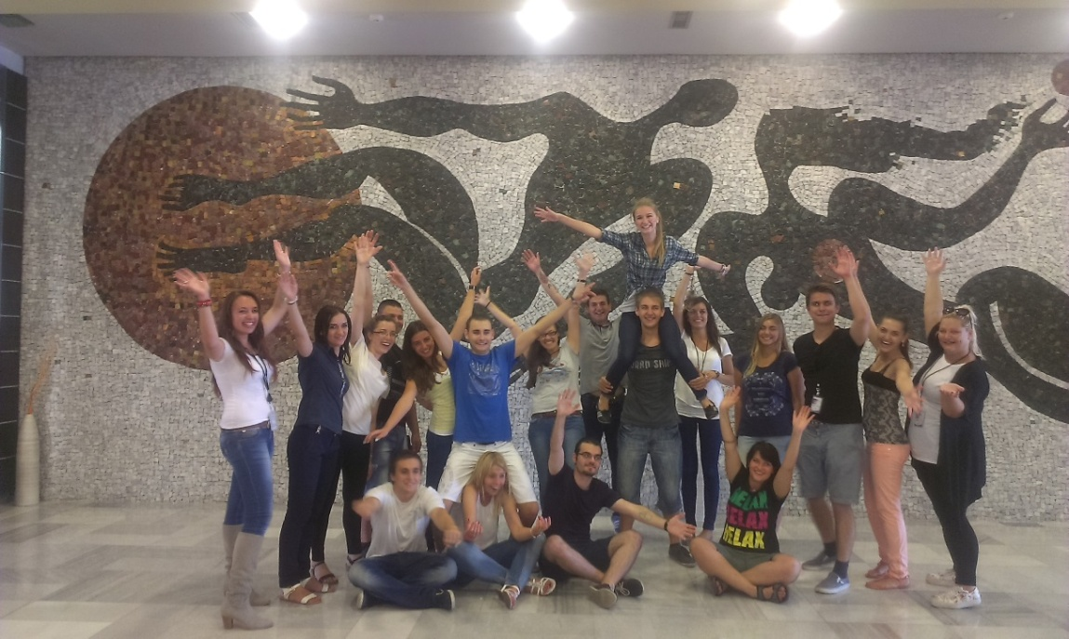
Talent Management
Internship programs
Leaning
Mentoring
Innovation
Creativity
Pro-activeness

Slide 13

Talent Management
Recognition & Rewarding activities
Adequate Remuneration and Benefits
Bonus related to the performance
Recognition & Rewarding Programs
Idea Management programs

Slide 14


Talent Management – Why?
OTHER PROJECTS IN HELP
Onboarding programs
Exit interviews

Slide 15

Talent Management – Benefits
Improved productivity (right person at the right place)
Strategic hiring process (attracting and selecting the right person)
Retaining the top talent (training, development, promotion, recognition)
=> know-how kept in the company, recruitment costs reduced
Improved employee experience
=> increased job satisfaction
=> higher motivation
=> increased engagement
Better professional development decisions
Understanding the employees better (perfromance appraisal)
Better Return on investment (focused training costs)
Business sustanability

Slide 16
Talent Management – Conclusion
Mc Donald’s founder Ray Kroc:
“If we are going to go anywhere, we’ve got to have talent. And I ‘m going to put my money in talent.”

